Slide 1
Zero Shot Image Classification Challenge ~CVPR
A CVPR Challenge, Understanding Unseen Images.

Slide 2
Group Members
Mirza Abdul Wasay
1
3
Irteza
22K-8731
22K-4087
2
4
Mudasir
Nihal Ali
22K-8732
22K-4054

Slide 3
Challenge Objective
Participate in the CVPR Blind Image Understanding Challenge.
Classify test images from the VizWiz dataset using Zero-Shot Learning.
No access to labeled training data.

Slide 4
Dataset Overview "VizWiz"
“VizWiz” A real-world blind user images dataset.
Highly diverse, noisy, and often low-quality images.
“VizWiz” Dataset Link: https://vizwiz.org/tasks-and-datasets/image-classification/

Slide 5
Research Paper Implementation
01
02
03
Visual Clustering
Optimal Cluster
Label Space Setup
04
05
06
Findings
Conclusions
Five Successive
Visual Clustering of training Images
Optimal Cluster
Count (k)
Label Space Setup (ImageNet-1K)
Implementation of Five Successive Techniques
Discussing Results of Techniques
More Techniques and Future Work

Slide 6
Visual Clustering of Training Images
Used CLIP’s image encoder (ViT-B/32) to extract 512-D embeddings for all training images.
Applied unsupervised clustering (KMeans) on image embeddings.
Goal: Group visually similar images (e.g. electronics, kitchen, clothing, etc).
Why ??
→ Since we don’t have labels, clusters help us simulate pseudo-label groupings.

Slide 7
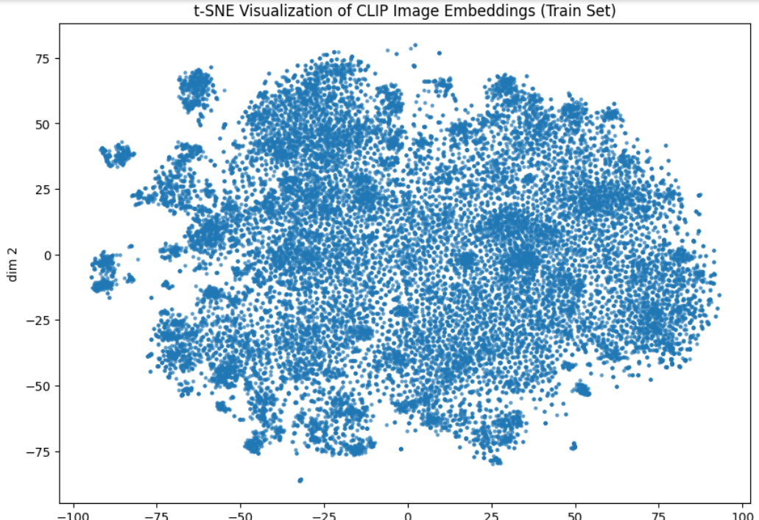

Slide 8
Optimal Cluster Count (k)
Performed elbow method to evaluate inertia (distortion score) vs number of clusters & Silhouette Score.
Selected k = 30 (depending on variant tried).
Stored each cluster’s centroid for similarity computation at test time.

Slide 9
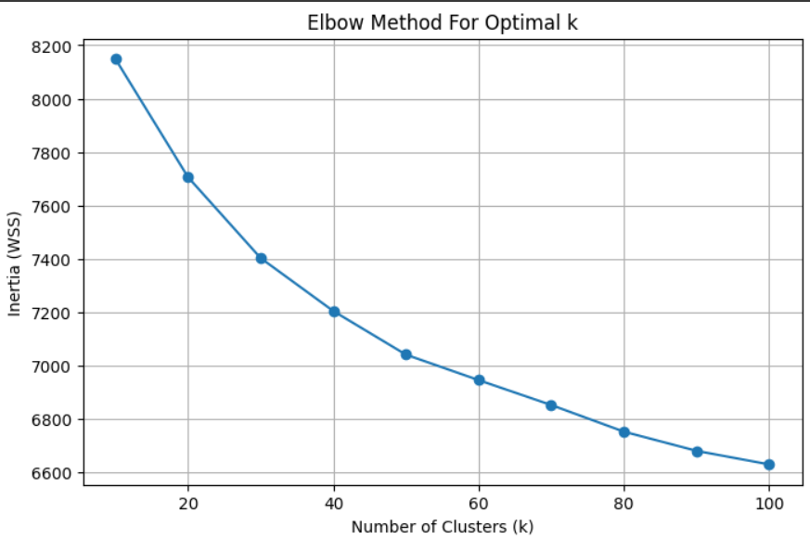

Slide 10
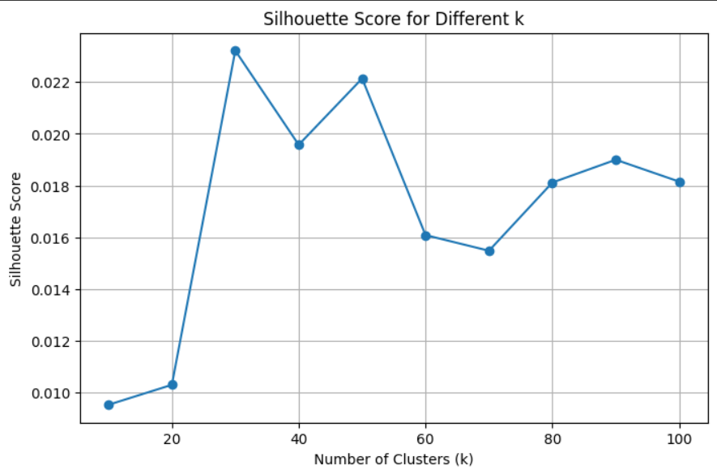

Slide 11
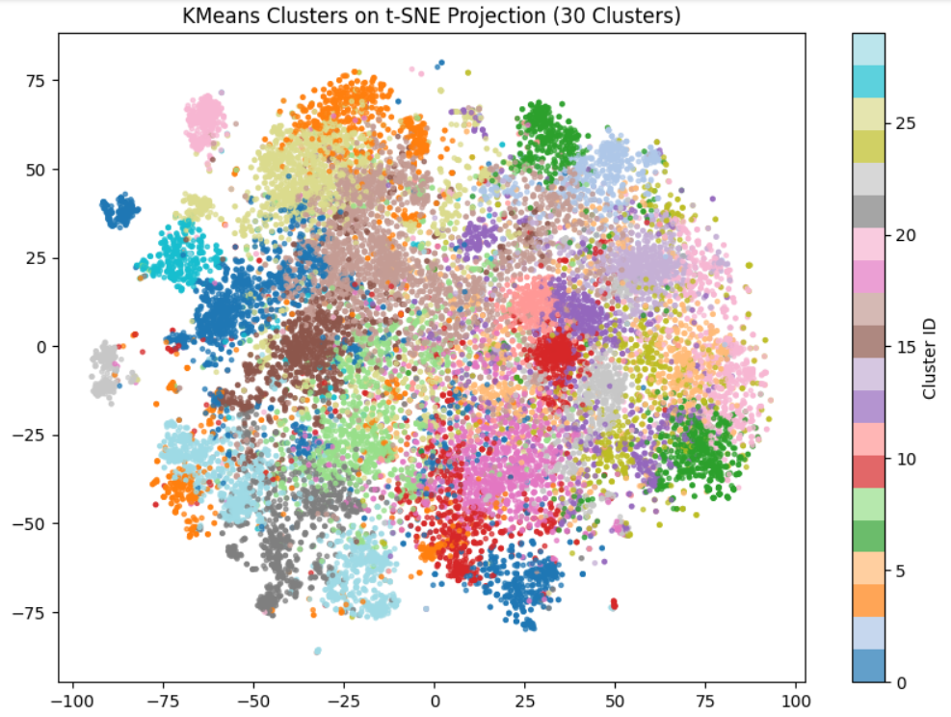

Slide 12
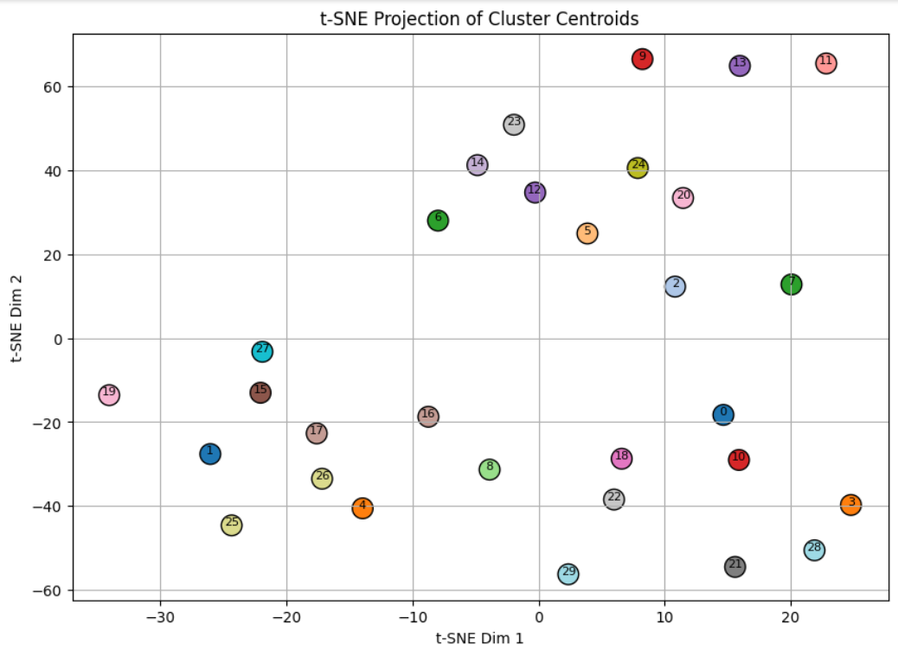

Slide 13
Label Space Setup (ImageNet-1K)
Retrieved 1,000 ImageNet class labels (imagenet_classes.txt).
These act as the universal label set for zero-shot classification.
.

Slide 14
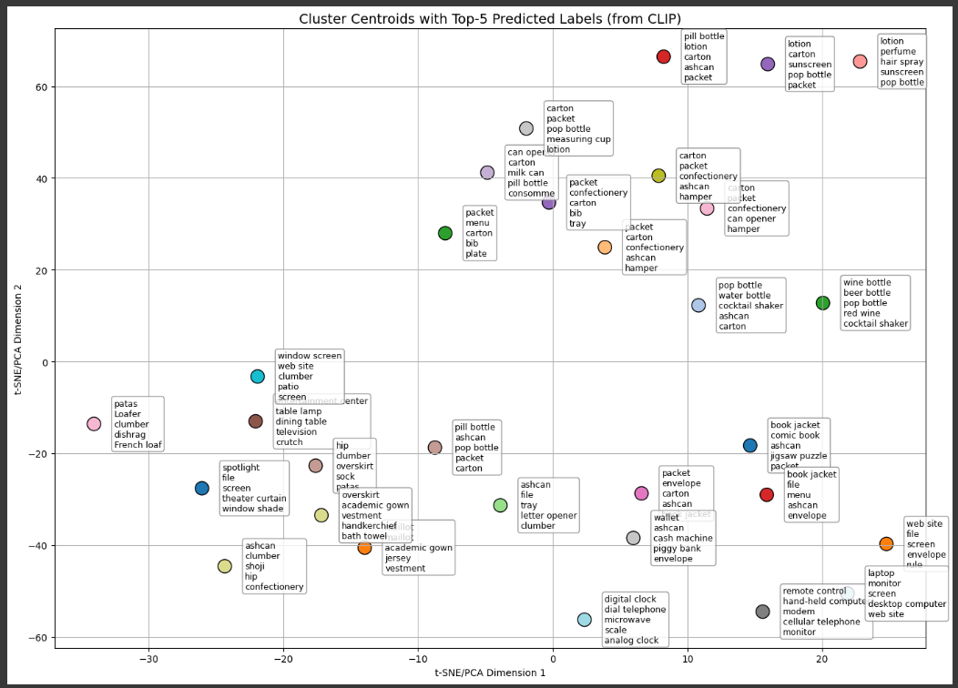

Slide 15
Methodology
Cluster Restriction
Prompt Ensembling
CR + PE
Techniques
Hybrid Similarity
Hybird + Cluster

Slide 16
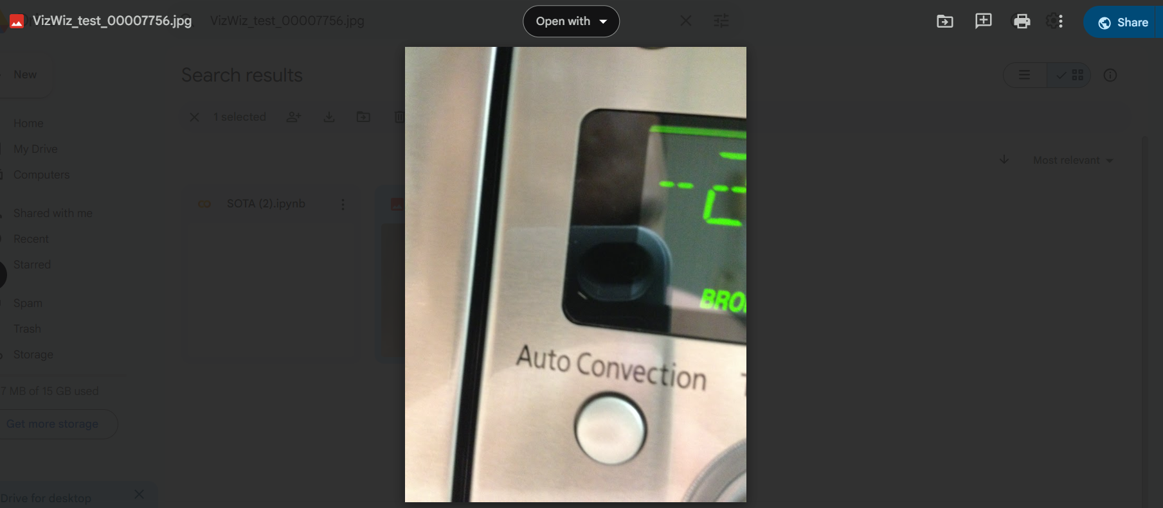
This is the test image we selected to get predictions for

Slide 17
Five Successive Techniques
We experimented with five levels of complexity and accuracy:
Cluster Restriction
Prompt Ensembling
Cluster Restriction + Prompt Ensembling
Hybrid Similarity (Image → Image + Image → Text)
Hybrid + Cluster (Best Accuracy)

Slide 18
1. Clustering Restriction
Finds nearest cluster to the test image based on CLIP embedding similarity (cosine).
Predicts only from labels assigned to that cluster (typically top-5–10 labels).
Performance depends on cluster quality — bad clusters can restrict true labels.
Performance depends on cluster quality — bad clusters can restrict true labels.
.

Slide 19
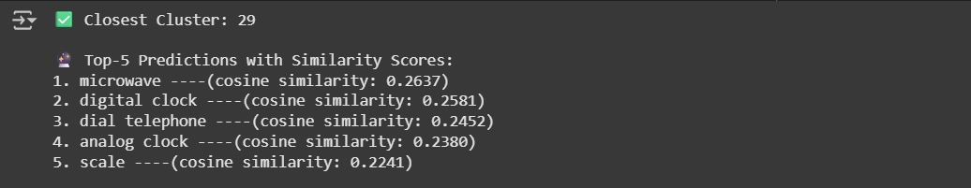
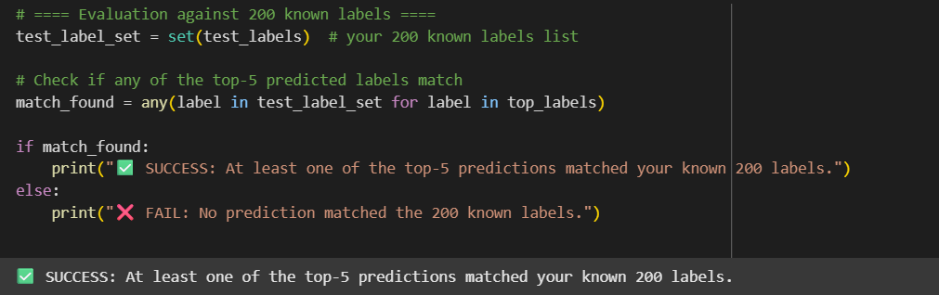

Slide 20
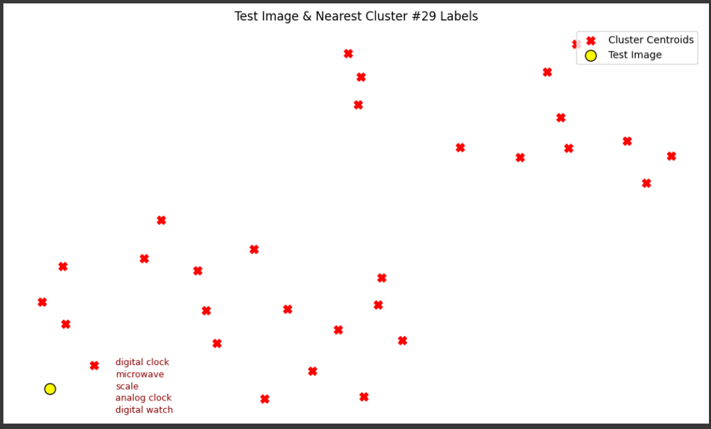

Slide 21
2. Prompt Ensembling
Goal of Prompt Ensembling: Improve the semantic alignment between CLIP’s text and image embeddings by generating richer textual context per label.
For each label, generate 10 natural language prompts (e.g., “a blurry photo of a Microwave”).
Encode all prompts using CLIP’s text encoder → average them to get one final embedding per label.
At inference time, encode the test image → compare with all prompt-ensembled label embeddings using cosine similarity.
Return top-5 labels with highest similarity scores.

Slide 22
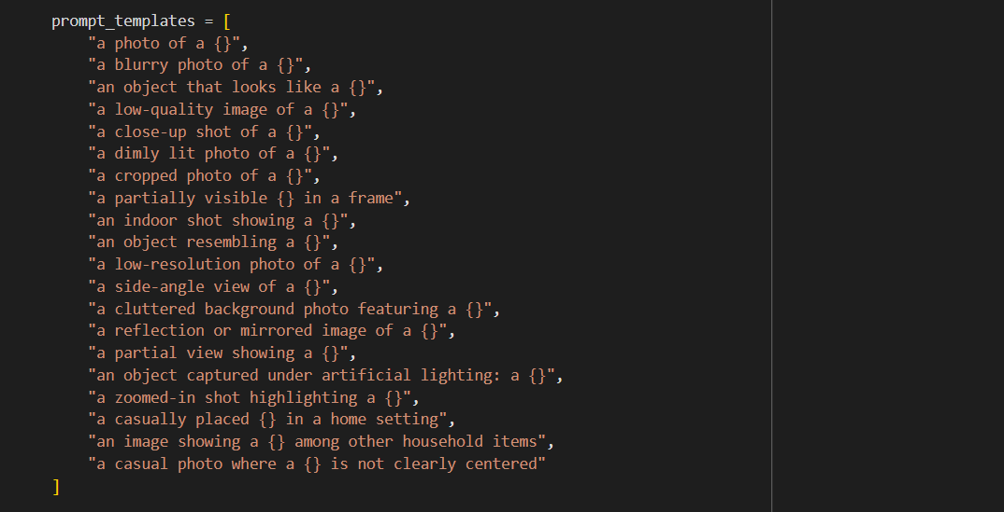
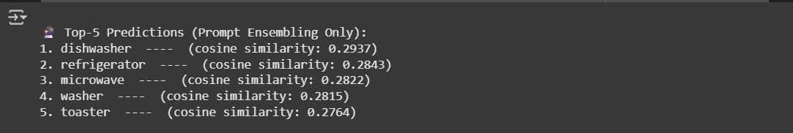

Slide 23
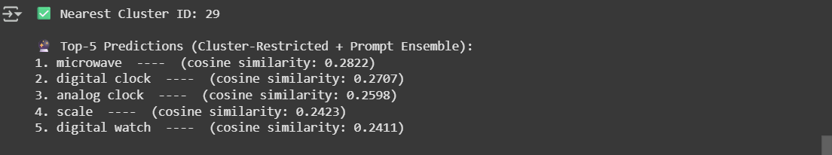
3. Cluster Restriction + Prompt Ensembling
At test time: a. Encode the test image using CLIP. b. Find the closest cluster (cosine sim with cluster centroids). c. Retrieve only the labels assigned to that cluster.
For each of those labels, generate 10 domain-aware prompts (e.g., "a blurry photo of a microwave").
Encode the prompts → take average → final text embedding per label.
Compare the test image with these cluster-specific label embeddings (cosine similarity).

Slide 24
4. Hybrid Similarity (Image → Image + Image → Text)
For each label in that cluster:
Generate 10 natural prompts → encode → average → get final label embedding (prompt ensemble).
Also find top-5 visually similar training images (image-to-image retrieval).
Predict pseudo-labels from those train images using CLIP zero-shot logic.
Combine both:
Text similarity score (image → label)
Visual voting score (image → similar images → label votes)
Weighted fusion: final_score = α × text_score + β × vote_score
Return top-5 predictions ranked by final_score.
(No use of Cluster Restriction)

Slide 25
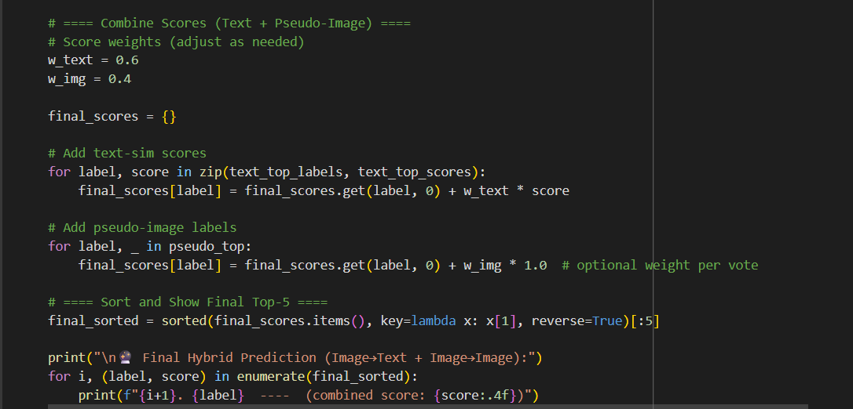
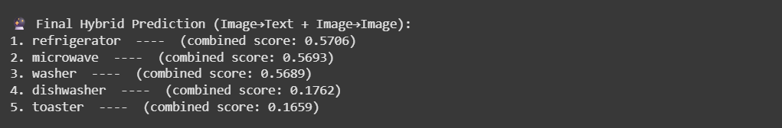

Slide 26
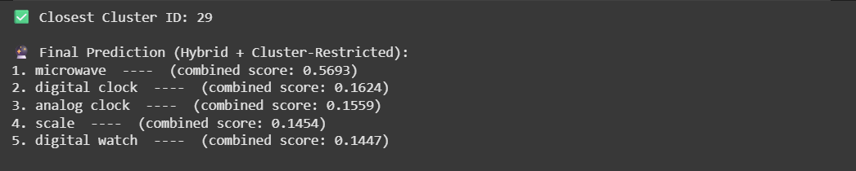
5. Hybrid + Cluster (Best Accuracy)
At test time:
Encode test image using CLIP.
Find the closest cluster (cosine similarity to centroids).
Retrieve only that cluster’s assigned labels.
Generate 10 prompts per label → encode via CLIP → average → final label embeddings.
Find top-5 visually similar train images → get pseudo-labels (zero-shot, restricted to cluster labels).
Combine both scores:
Text sim (image → label) + Visual vote (image → images → label)
Return top-5 labels ranked by combined score.
(By using Cluster Restriction)

Slide 27
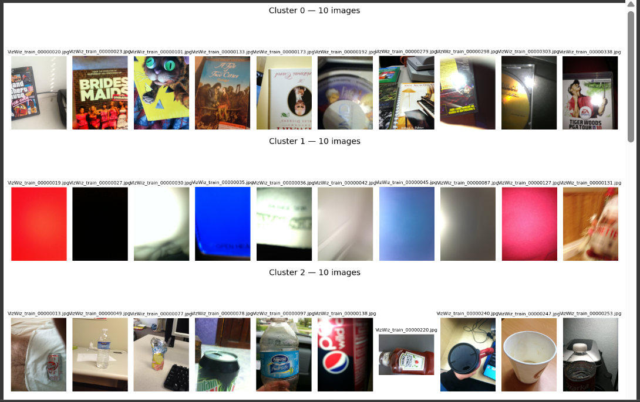
Here are some of the training data Clusters

Slide 28
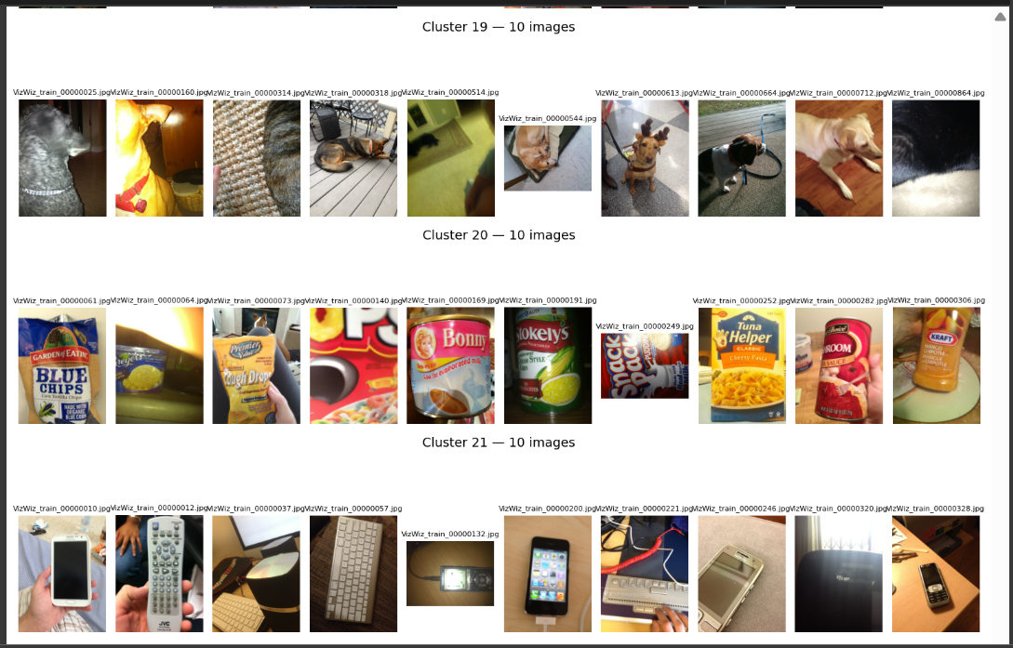

Slide 29
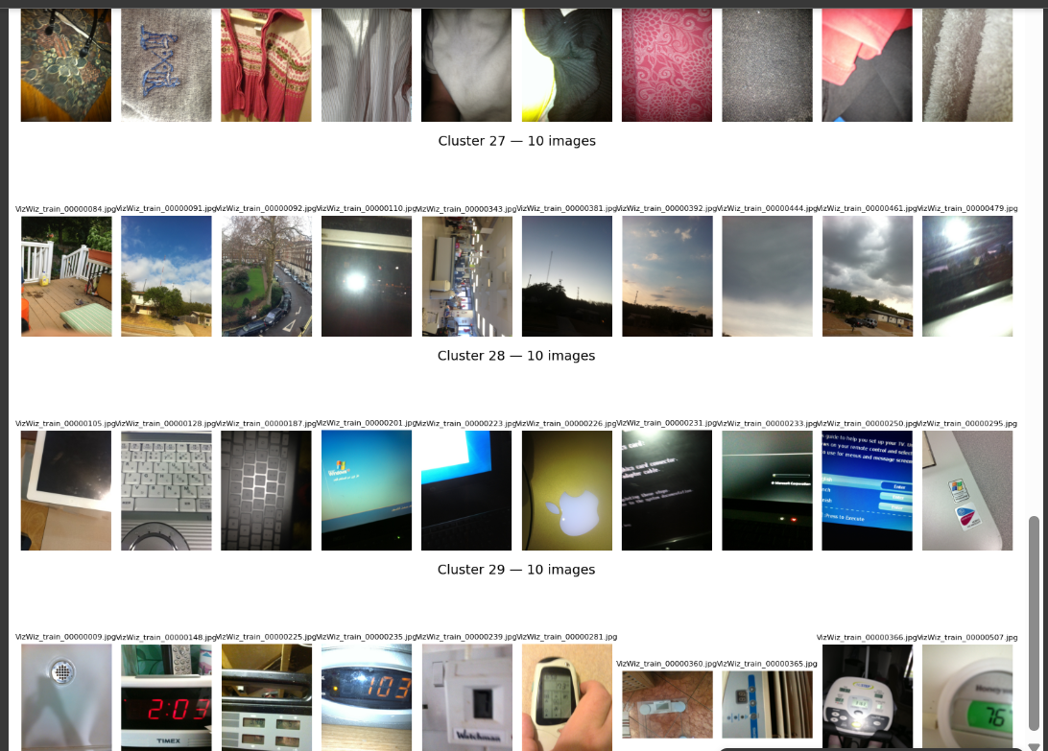

Slide 30
Conclusion
In this project, we explored five zero-shot classification techniques using CLIP:
Cluster-Only (No Ensembling) - Basic filtering using clustered label subsets; simple but low semantic strength.
Prompt Ensembling Only – Used full label space with no restrictions; broader guesses but often confused
Cluster + Prompt Ensembling – Added domain-tuned prompt variation, improving semantic alignment and prediction quality
Hybrid + Cluster (Best) – Fused prompt ensembling, cluster-based label restriction, and pseudo-label voting; achieved the most precise and context-aware predictions without needing labeled training data

Slide 31
Thank You
Do you have any question?

